Slide 1
What is Civics?

Slide 2
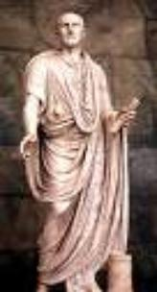
Civics
The study of the rights and duties of citizens and their government
Concept of citizenship dates back more than 2500 years

Slide 3
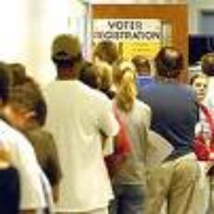
Citizens
= A legally recognized member of a country, who...
Owe loyalty to the government and are entitled to protection from it
Agree to follow a set of rules
Accept government's authority

Slide 4
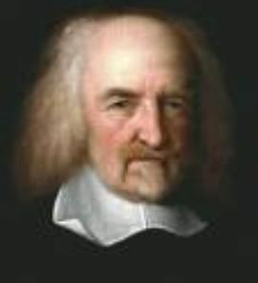
Government
For there to be citizens, there has to be a government
Without government life would be “solitary, poor, nasty, brutish, and short”
– Thomas Hobbes

Slide 5
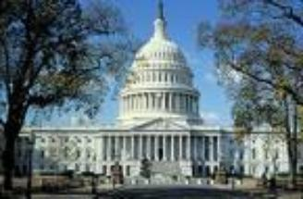
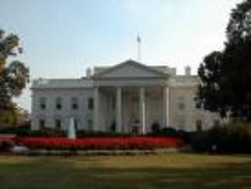
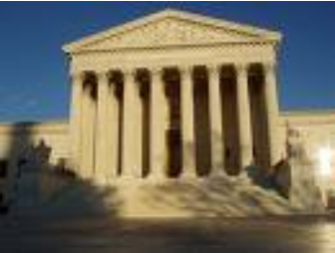
So what is government?
A ruling authority for a community
Any organization that has the power to make and enforce laws and decisions for its members

Slide 6
What does government do?
4 Functions
Keep order
Settle conflicts
Support the community
Provide services that individuals can’t provide independently
Guide the community
Plan for the future by setting policies
Makes the budget
Interacts with the community

Slide 7
Discussion
What are some things all citizens have to do?
What are some things all citizens should do?
How does a person become a US citizen?

