Slide 1
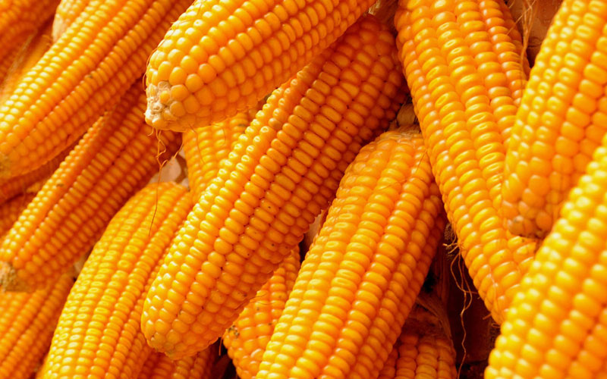
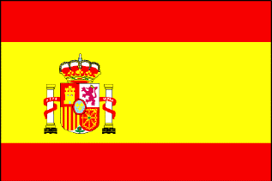
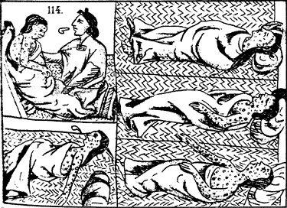
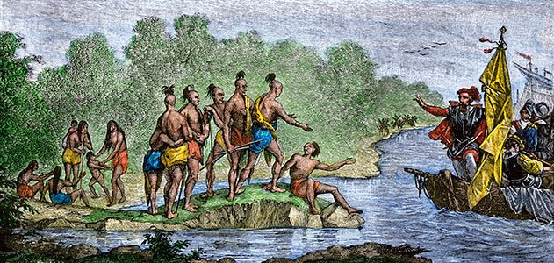
Period 1: 1491-1607
#Accident #Columbusdontgivethatguyaholiday #Impactofgolboalization
Aztec scribes before conquered

Slide 2
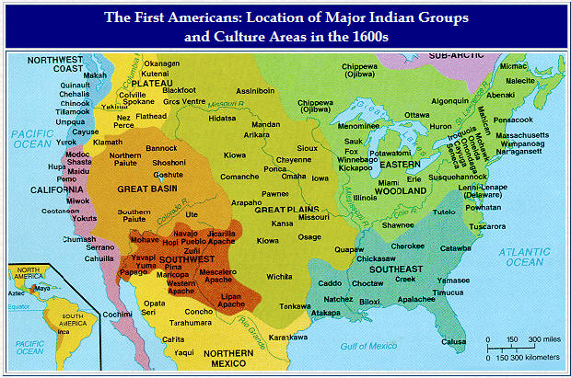
1.1- Native American Migration and Settlement
Why settle?
Maize cultivation- leads to settlement, begins in the southwest.
IMPACT
Leads to massive settlement known as pueblos
Build large irrigation systems to adapt to their environment.
Population increase=constant food source
Development of diverse societies
Ex- Tenochtitlan= 250,000 and various social classes.

Slide 3
1.1 continued adopting to environment
Great Basin and Plains
Primarily Nomadic- arid and dry.
Horse allows Natives to become more powerful military and hunt easier (bison)
Brought by Europeans around the late 1500’s
Northeast-
Hunter Gathers, settled around corn cultivation
Burned forest for crops and hunting.
Matriarchal society*****
Power based on female authority
tended to crops and ran tribal meeting if male chief died.
European society= patriarchal

Slide 4
Environmental Impact
South East- 5 civilized tribes
Cherokee, Chickasaw, Creek, Choctaw, Seminole
Mostly intermarried with Whites creating mestizo culture.
Northwest/ California
Hunting, gathering, fishing.
Chinook- had advanced fighting techniques and longhouses- many families living together.

Slide 5
What you might see:
What is the primary reason Natives begin to settle?
Once Natives begin to settle, how does their environment impact the way they live?

Slide 6
Period 1.2- Impact of the Columbian Exchange
Reasons for European Exploration: (Mainly Spain)
Political
Unification of the Spanish Crown (Ferdinand, Castile and Isabella, Aragon) Following years of batting Islam and each other
Technology
Compass, Carvel (ship that navigates winds better), Prince Henry’s School of navigation, and printing press (1500’s)
Religion
Spread of Christianity – Conquistadores, defeat Islam.
Cheap Labor
Mine gold and silver- Encomienda system- Marshaled (forced) conversion and labor.
Renaissance
Leads to Discovery and optimism.
Marco Polo- 1295
Need for new Sources of Wealth
Increased population and deforestation
Competition- Portugal, England, France, Ottomans

Slide 7
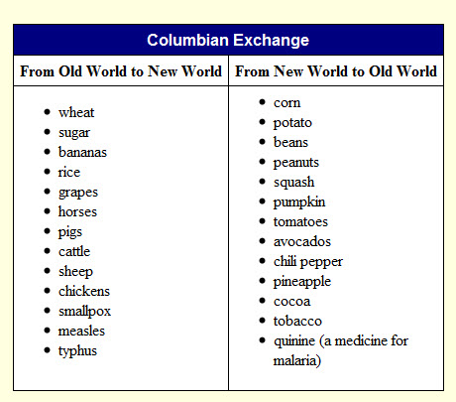
Columbian Exchange

Slide 8
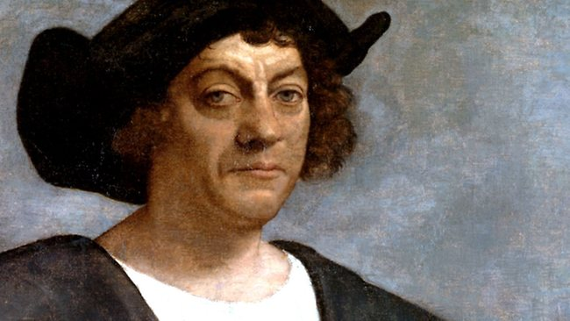
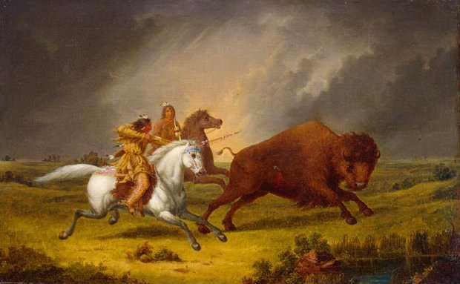
Period 1.2- Impact of the Columbian Exchange
What is it?
Exchange of goods, services, and diseases between the New World, Europe, and Africa.
Effects of the Columbian Exchange:
Creates an Interconnected Global Economy
Europe provides the markets, capital, and technology transition from Feudalism to Capitalism. →Creation of Joint Stock Companies (England)
Africa provides the Labor
New World provides raw materials
Europe: New Foods bring a population boom and healthier diet (potato, corn, sugar, wheat)
Africa- Higher demand for slaves
Natives- Death and disease ie-SMALLPOX!!!!!
Between encomienda and smallpox, Native populations are wiped out #thankscolumbus
Positive? New Culture Miztizo, Mullato, Creole.
Positive- Horses for the Natives and Plains Indians.

Slide 9
1.3- How does exploration change the culture and views of Natives, Africans, and Europeans?
Da la casas reading
Treatment of Natives.
Europeans saw Natives as “Savages”
Native and Europeans:
Land: Natives had no sense of land ownership (Great Spirit)
Patriarchal vs Matriarchal
Woman could take over tribes, hunt, took care of crops.
Religion- Animism and polytheistic vs monotheism
Positive:
Helped each other sharing technology and agricultural techniques.
Africans seen as Inferior and created their own culture
How does this differ from the Natives?

Slide 10
Why did the Natives Fight?
Wanted autonomy, Starving time and defense.
Pope’s Rebellion:
1680 The Natives (Pueblo) rebelled against missionaries in Sante Fe.
They destroyed churches and built up temples on the ruins (Kivas). It took 50 years for the Spanish to gain the grounds back.
Spanish treatment of Natives leads to the Black Legend !!!!!!!

Slide 11
Review:
Short Answer Practice:
How did the Columbian Exchange impact one of the following groups:
Europeans
Natives
Africans
Explain another impact of one of the other 2 you did not choose
How does the Columbian Exchange lead to the development of the American Colonies?
Tarasco says: “Congrats on finishing your first APUSH Unit!!!!

